Slide 1


BVPMOSC
www.bvpmosc.org | info@bvpmosc.org | www.blog.bvpmosc.org
Akshay Katyal
Devesh Batra
CSE , 3rd Year
IT , 3rd Year
akshay@bvpmosc.org
devesh@bvpmosc.org
Co-founder
Co-founder
Amit Sharma
CSE , 3rd Year
amit@bvpmosc.org
Manager

Slide 2






Slide 3

Mozilla and its mission
Focus on People rather than Profit
Promoting Open Web
Community approach to create Awesome Open Source Software
Notes:
- Mozilla Mission Video : http://videos-cdn.mozilla.net/brand/Mozilla_Firefox_Manifesto_v0.2_640.webm

Slide 4




Open Source

Slide 5
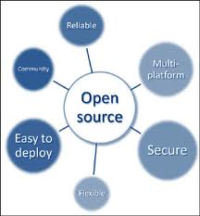

Why Open Source

Slide 6

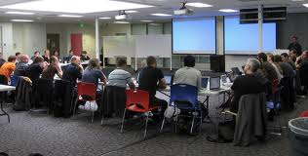
What will we do ?
Evangelize Open Source
Regular Workshops/Seminars
Contribution and Development of Open Source Projects
OSS Code Labs
Hackathons

Slide 7
Workshops Planned
Introduction to Linux
Version Control Systems such as subversion and git Firefox Add-on Development Open Source Softwares like Gimp,Emacs Open Source Libraries like Qt , GTK+ , OpenCV
Adobe Edge Server side languages such PHP , Ruby ,Python etc Cloud Technologies like Google App Engine , Amazon aws Open source Systems like Drupal , Wordpress , Joomla! Developing Apps for Firefox OS

Slide 8
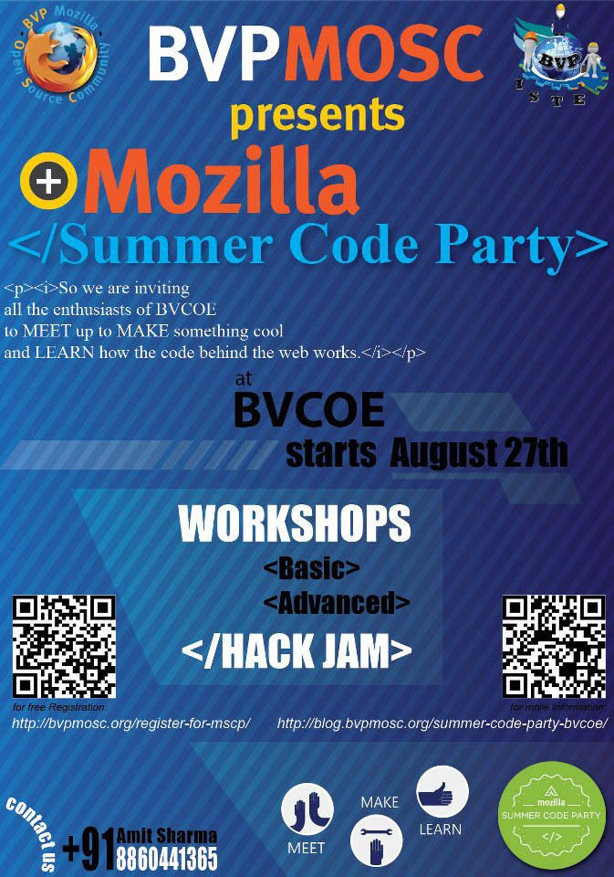

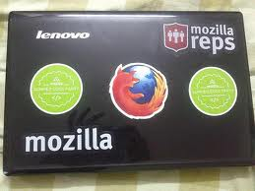
The Summer Code Party

Slide 9

Agenda
<Summer Code Party>
<Basic Workshops>
<Open Web/>
<HTML5/>
<CSS/>
<Basic JavaScript/>
<Web Fundamentals/>
</Basic Workshops>
<Advanced Workshops>
<Web App Architecture/>
<Introduction to Wordpress/>
<Advanced JavaScript/>
</Advanced Workshops>
</Summer Code Party>

Slide 10



Calling contributors

